Slide 1
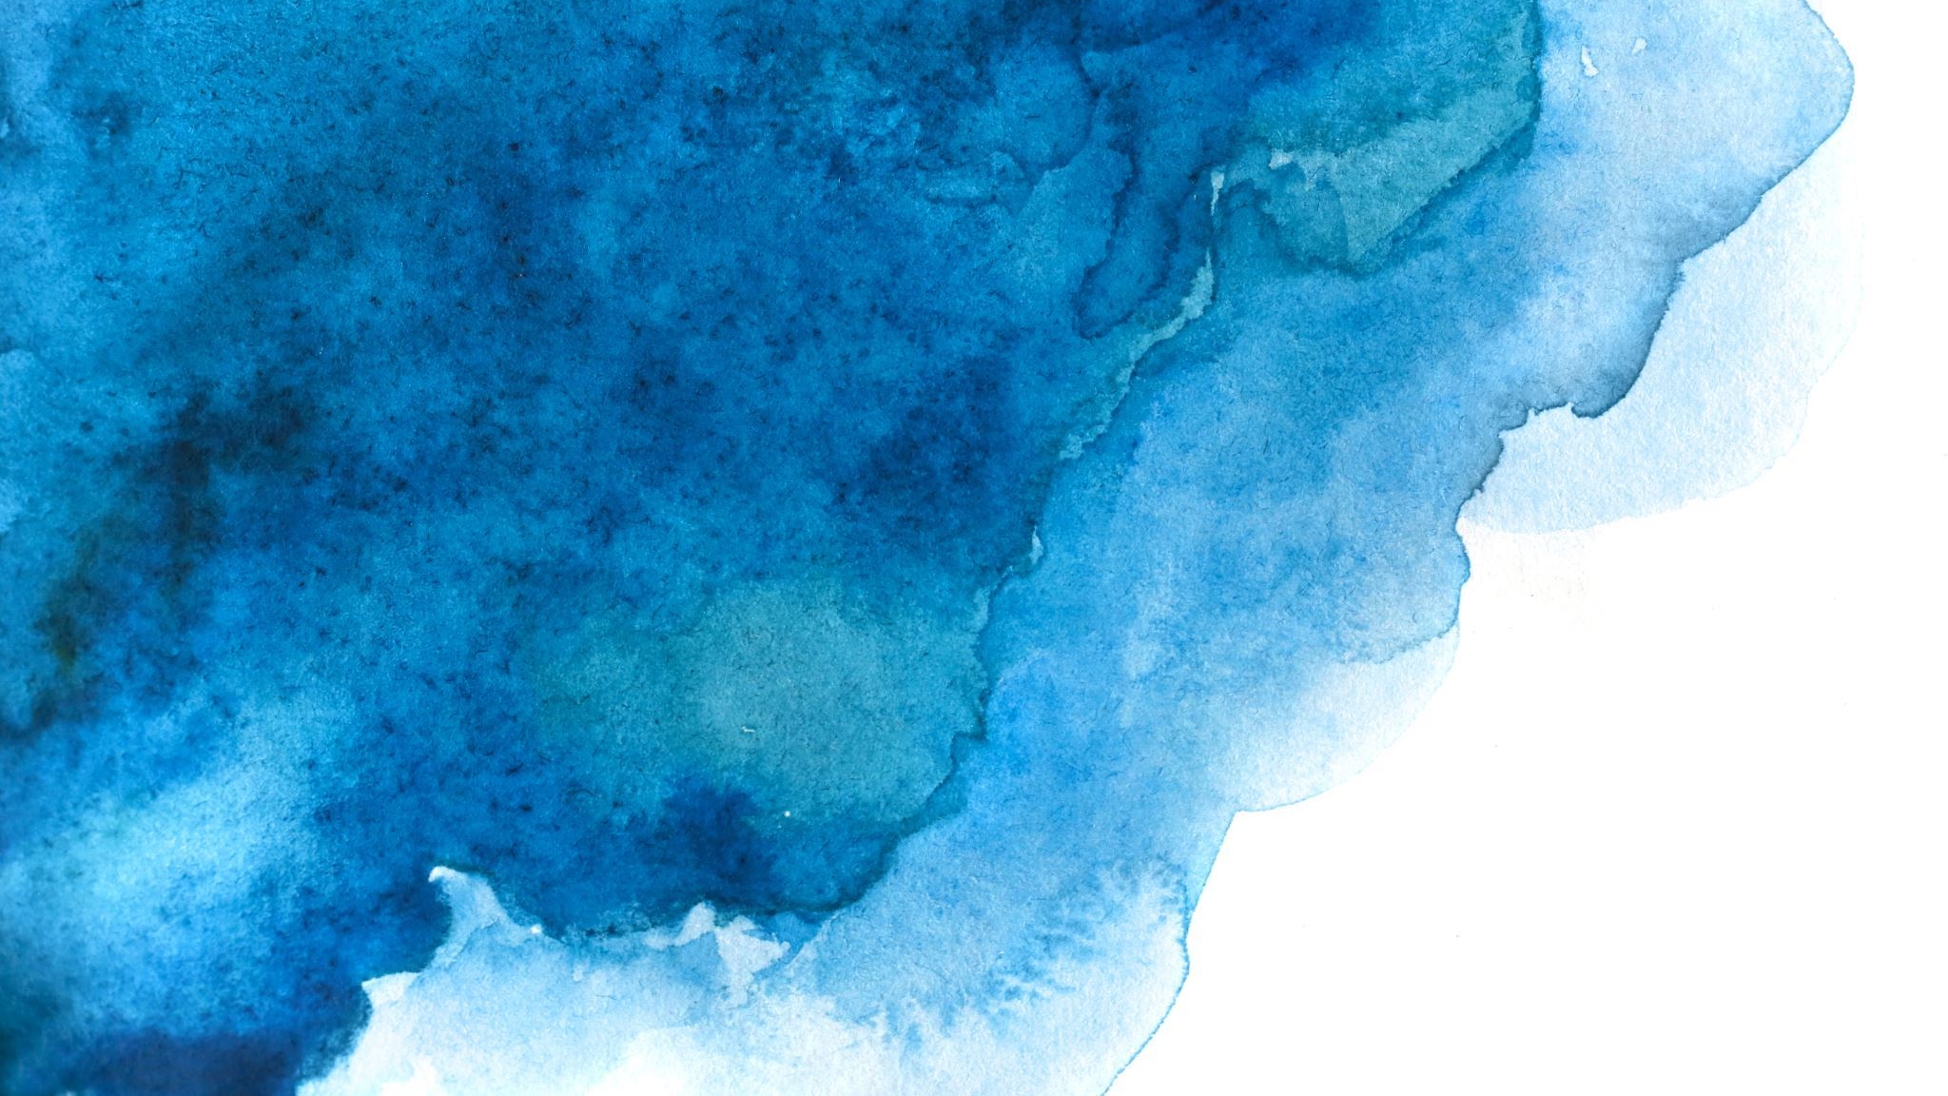
Macrophytes in and around Begur Lake and Gottigere Lake
Presidency School Bangalore South
A study of the vegetation present in and around two prominent lakes of South Bengaluru – Gottigere lake and Begur lake.
By ​
Prathith. A and Johann Job, GRADE 9
PRESIDENCY SCHOOL BANGALORE SOUTH

Slide 2
1. Introduction
Lakes are an integral part of Bangalore’s history and heritage. While some were naturally formed, some started out as man-made tanks for water storage. As they are a key element of the natural ecosystem, they must be protected through scientific means and policies. Through the study of the macrophytes we can assess the overall health of a lake.
For this study we picked two of the large & reasonably well-kept lakes in South Bangalore – Gottigere lake and Begur lake. Both lakes are known to be a home to a variety of flora and are popular among nature lovers and birdwatchers.

Slide 3
1. Introduction – What are macrophytes ?
Macrophytes are plants that have structures that are usually more complex, interdependent, and physically substantial
They are of 3 types-
Emergent - Emergent plants live near the water’s edge and along the banks of rivers.
Submerged - Submerged macrophytes are also rooted to the bottom but their leaves grow entirely underwater.
Floating - Free-floating macrophytes are found suspended on water surface with their root not attached to the substrate, sediment, or bottom of the water body.

Slide 4
1. Introduction – Macrophytes as bio-indicators
Bioindicators include biological processes, species, or communities and are used to assess the quality of the environment and how it changes over time.
Macrophytes respond to changes in the nutrient concentrations in their environment and can thus provide a more comprehensive assessment of river ecosystems. .

Slide 5
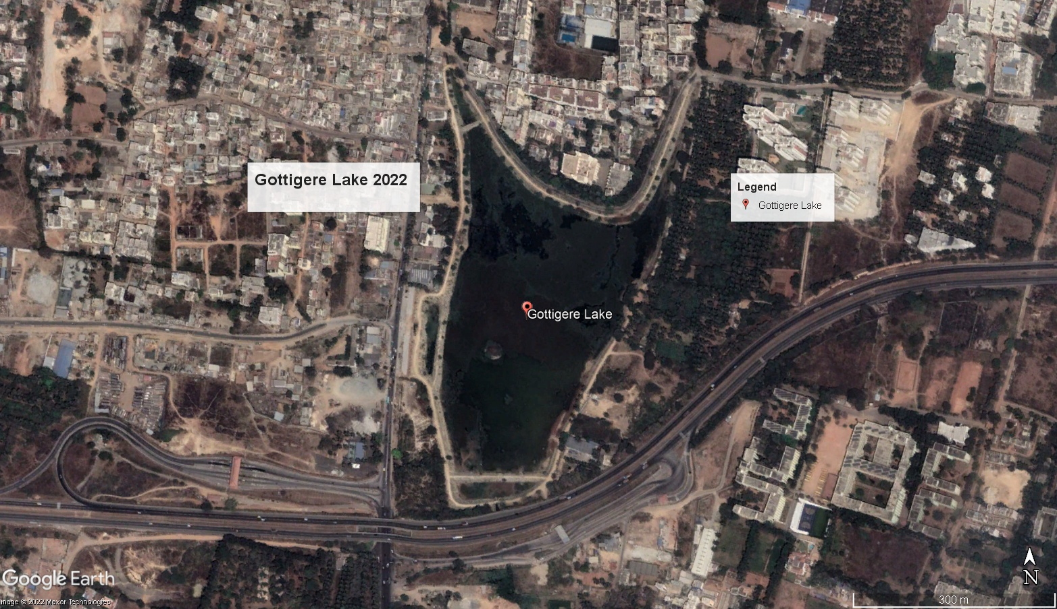
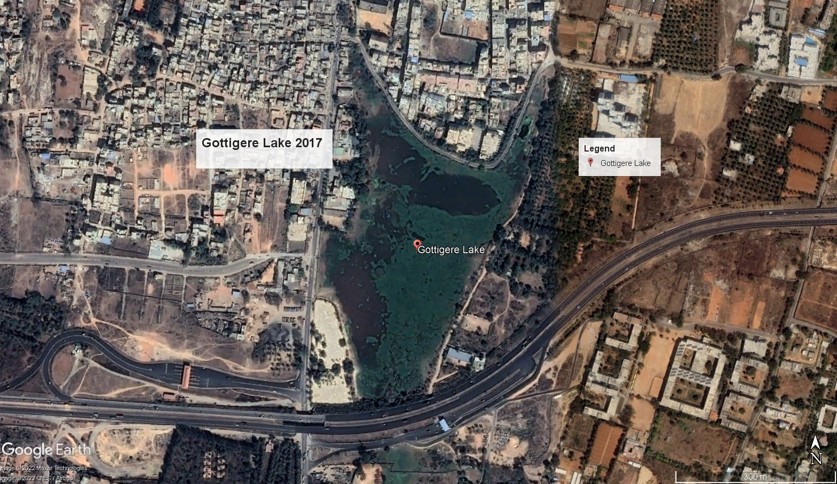
2. Study Area A : Gottigere Lake
Located at the coordinates- 12°51'7.98"N 77°35'25.20"E
Area as per RTC = 37.33 Acre

Slide 6
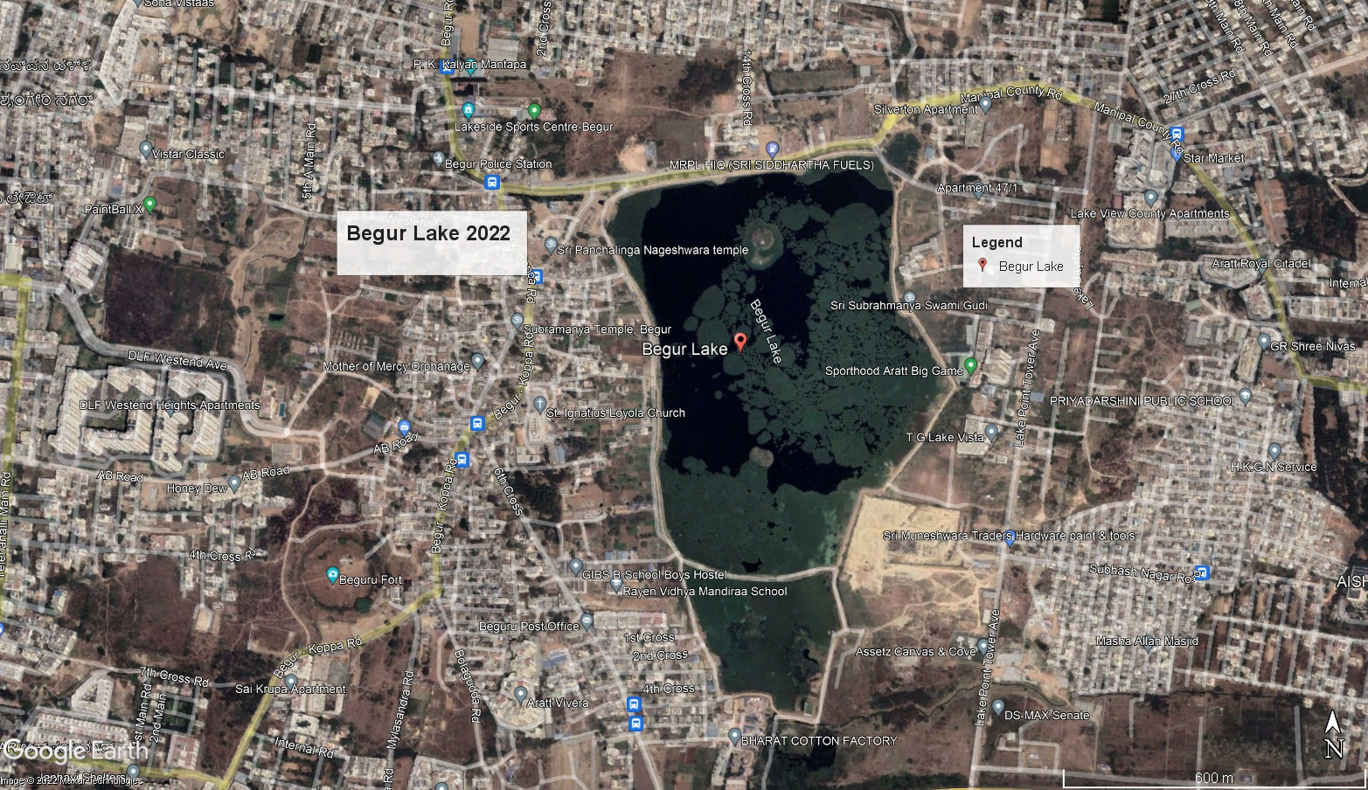
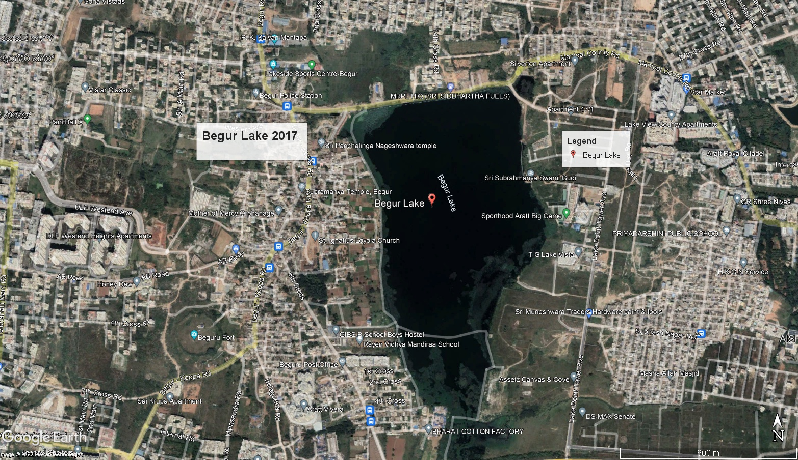
2. Study Area B : Begur Lake
Located at the coordinates- 12°52'21"N 77°37'48"E
Area of the lake as per RTC = 137.6 acres

Slide 7
3. Materials & Methods
3.2 Methods: i) Photography of macrophytes ii) Identification of leaves & Phyllotaxy of plants iii) Identification through barks of trees.
3.1 Materials: i) GPS ii) Measuring Tape iii) Camera iv) Google Earth v) Google Lens vi)Plantnet

Slide 8
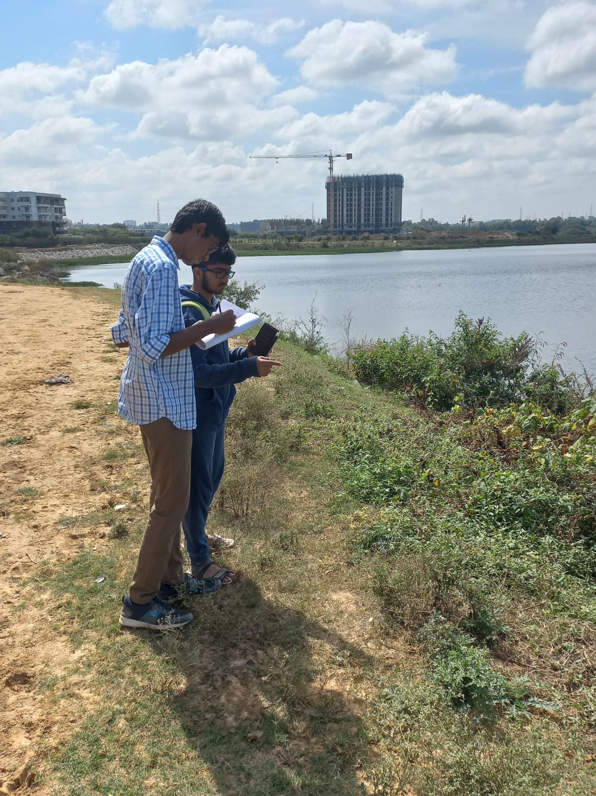
Making observations - (19/11/22) & (3/12/22)
Gottigere Lake
Begur lake

Slide 9
4. Objectives
Observe plant density by visiting and taking pictures at Gottigere Lake and Begur Lake.
Identify the various plant species and record their frequency of occurrence at each site.
Record the area covered by macrophytes in each case.
Provide a comparison study on the vegetation found in both lakes.

Slide 10
5. Area covered by macrophytes (GOTTIGERE LAKE)

Slide 11
5. Results (GOTTIGERE LAKE)
1. More Frequent -
NAME | AREA COVERED | PERCENTAGE OF AREA COVERED
Water Hyacinth | 64,964 m² | 54.2%
Parthenium and Touch me not | 1,962 m² | 1.63%
Biscuit grass | 2,914 m² | 2.4%
Slender Knotweed | 2,948 m² | 2.46%
Scotch Grass | 4,730 m² | 3.94%
Water Thyme​ | 964 m²​ | 0.8%​
Finger Grass | 601 m² | 0.5%
Beech | 222 m² | 0.15%
Castrol | 40 m² | 0.03%

Slide 12
5. Results (GOTTIGERE LAKE)
2. Less Frequent (descending)
Purple Fountain grass
Beech
Coconut trees
Morning glory
Asparagus Fern
Denseflower Knotweed
Tree Dahlia
Wild Almond
Species that were spotted once or twice-
Mango
Teak
Goat weed
Singapore Cherry

Slide 13
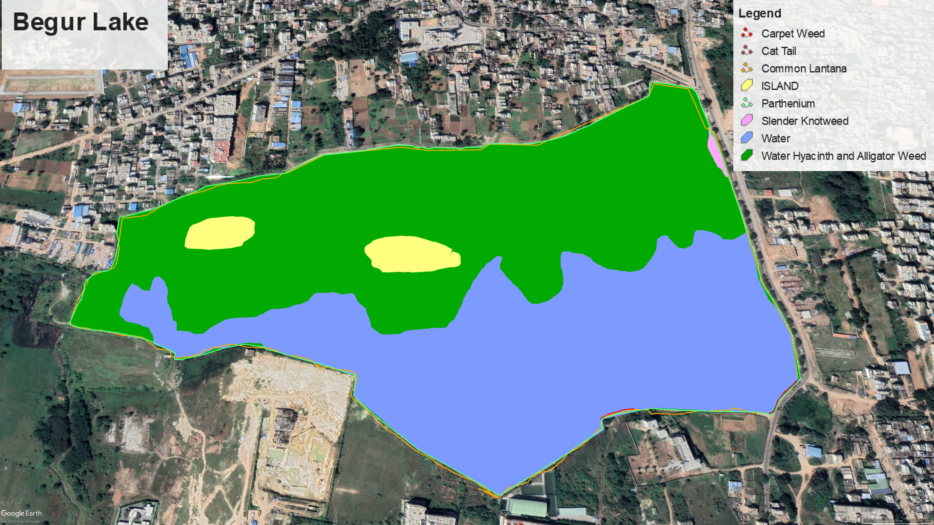
Area covered by macrophytes (BEGUR LAKE)

Slide 14
5. Results (BEGUR LAKE)
NAME​ | AREA COVERED​ | PERCENTAGE OF AREA COVERED​
Water Hyacinth ​and Alligator weed | 2,70,114 m²​ | 55.9%​
Parthenium | 3158 m²​ | 0.66% ​
Common Lantana | 3182 m²​ | 0.66%​
Slender Knotweed | 1223 m²​ | 0.25%​
Cat-tail | 77.8 m²​ | 0.016%​

Slide 15
5. Results (BEGUR LAKE)
2. Less Frequent (descending)
Calotropis
Carpet Weed
Finger Grass
Water thyme
Purple Fountain Grass
Bush Morning Glory
Species that were spotted once or twice-
Indian Beech
Hackberry
Lemon
Roundhead Bulrush

Slide 16
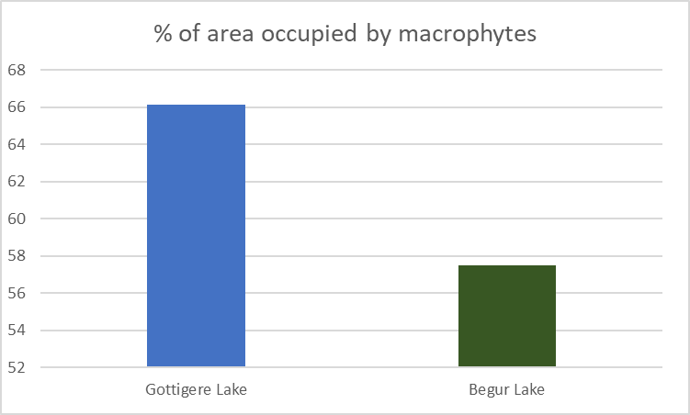
6. Comparison
Lake | % of area covered by water hyacinth | % of area covered by all vegetation in total | Most prominent species
Gottigere Lake | 54.2 | 66.11 | Water hyacinth Parthenium Touch me not Biscuit Grass
Begur Lake | 55.9 | 57.49 | Water Hyacinth Parthenium Slender Knotweed Common Lantana

Slide 17
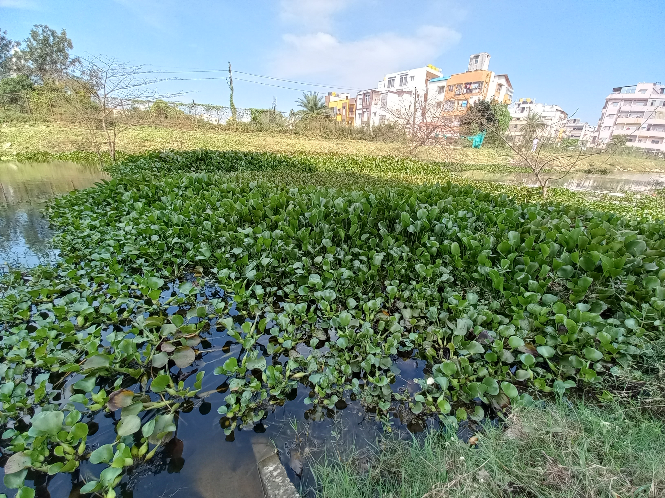
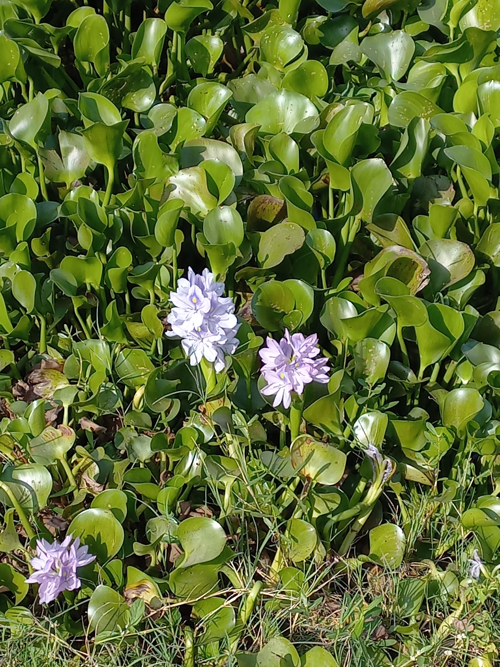
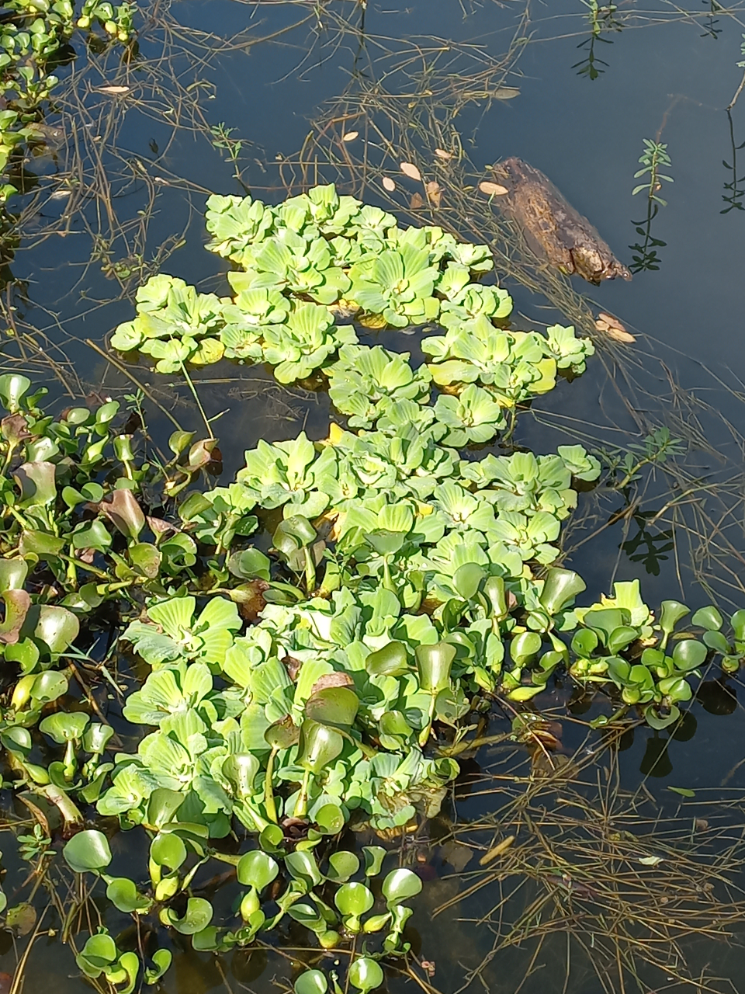
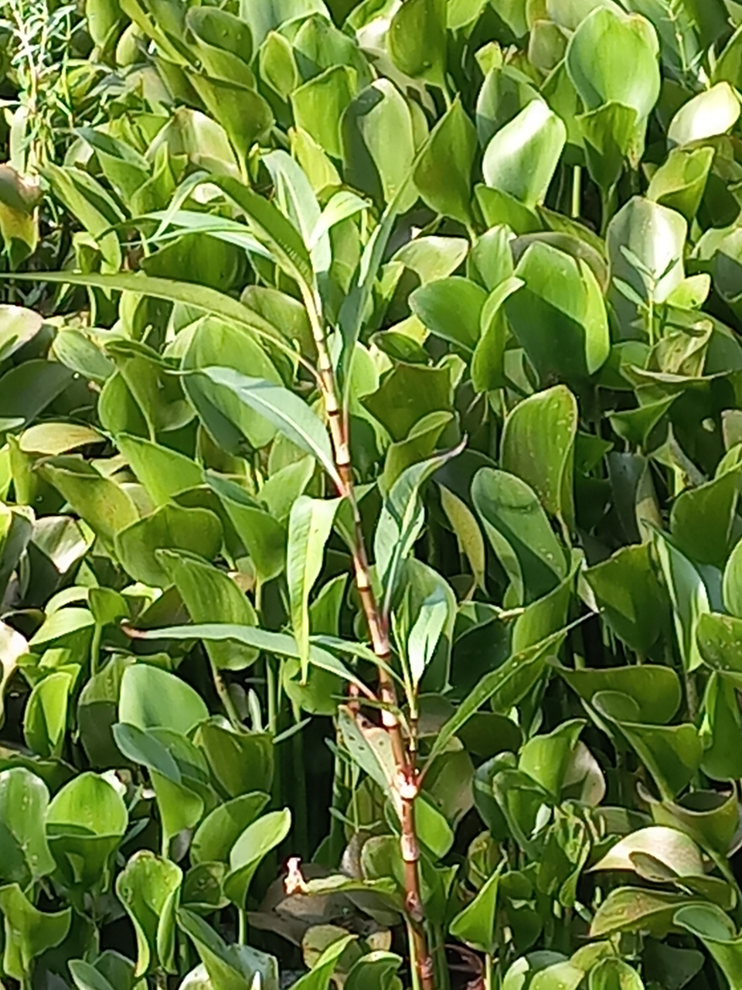
7. Gallery (GOTTIGERE LAKE)
Common Water Hyacinth (Eichhornia crassipes)
Watter lettuce
(Pistia stratiotes)
Slender Knotweed
(Persicaria decipiens

Slide 18
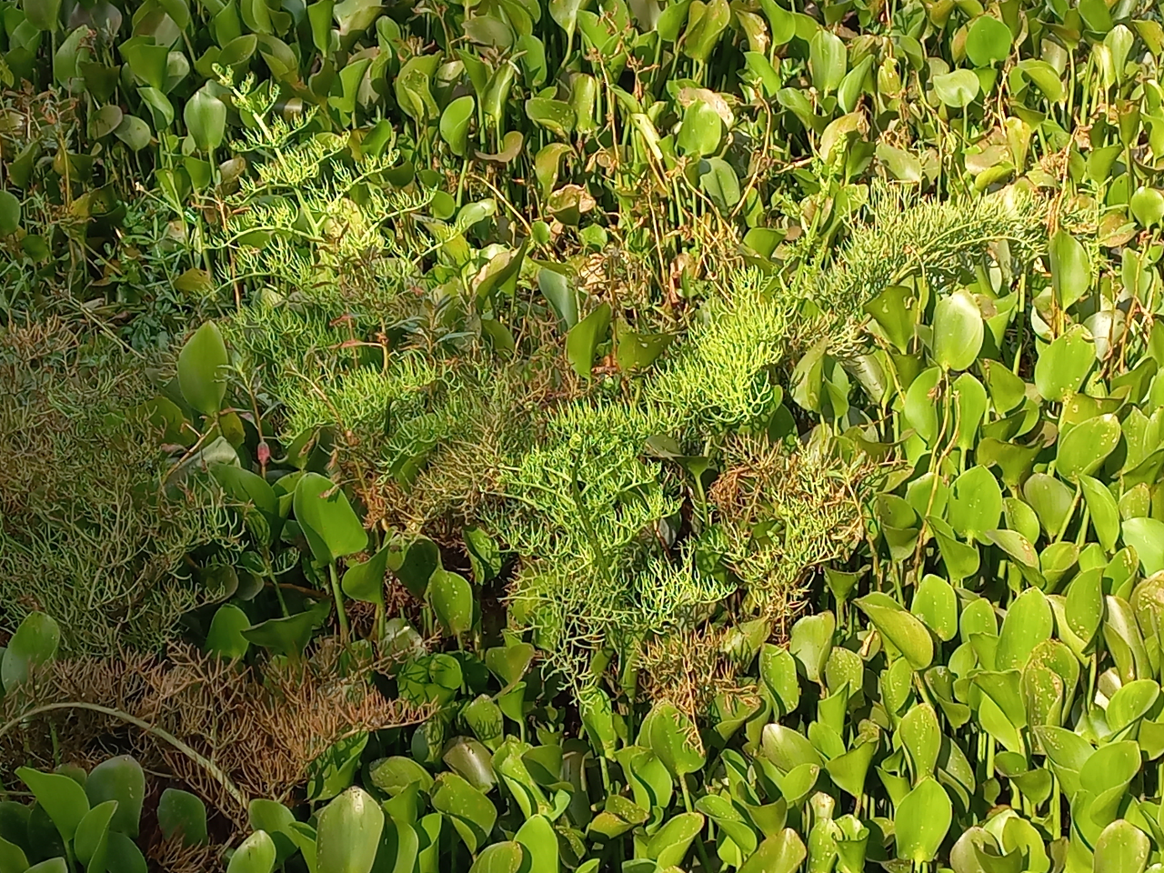
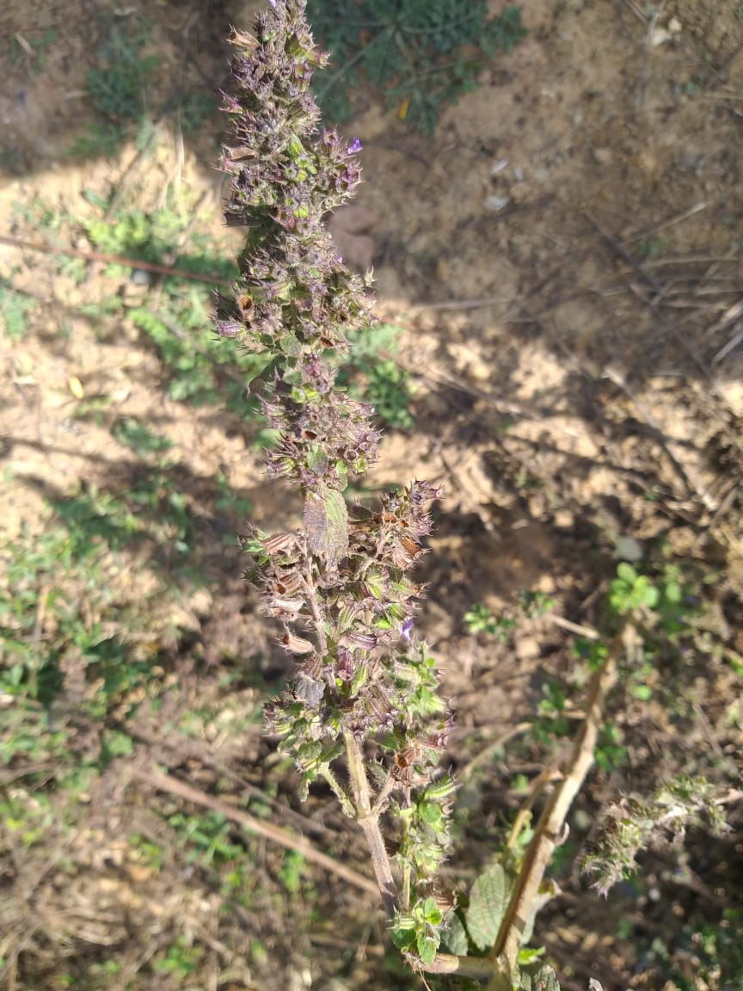
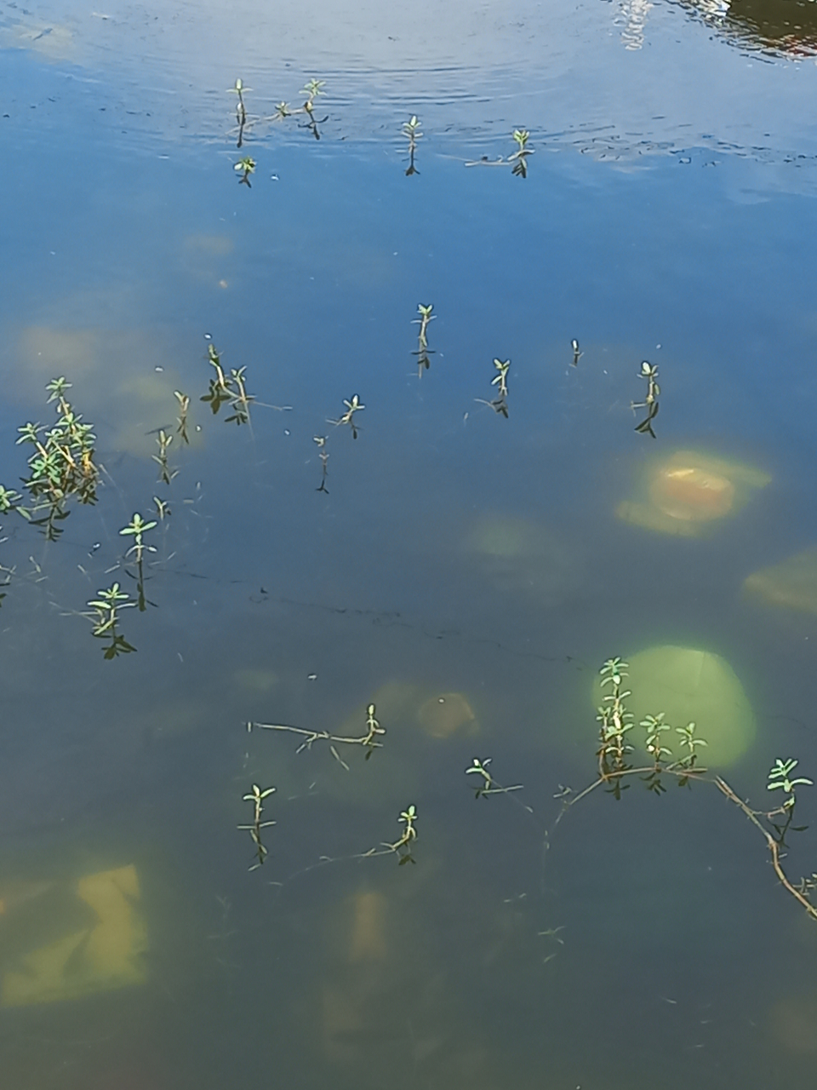
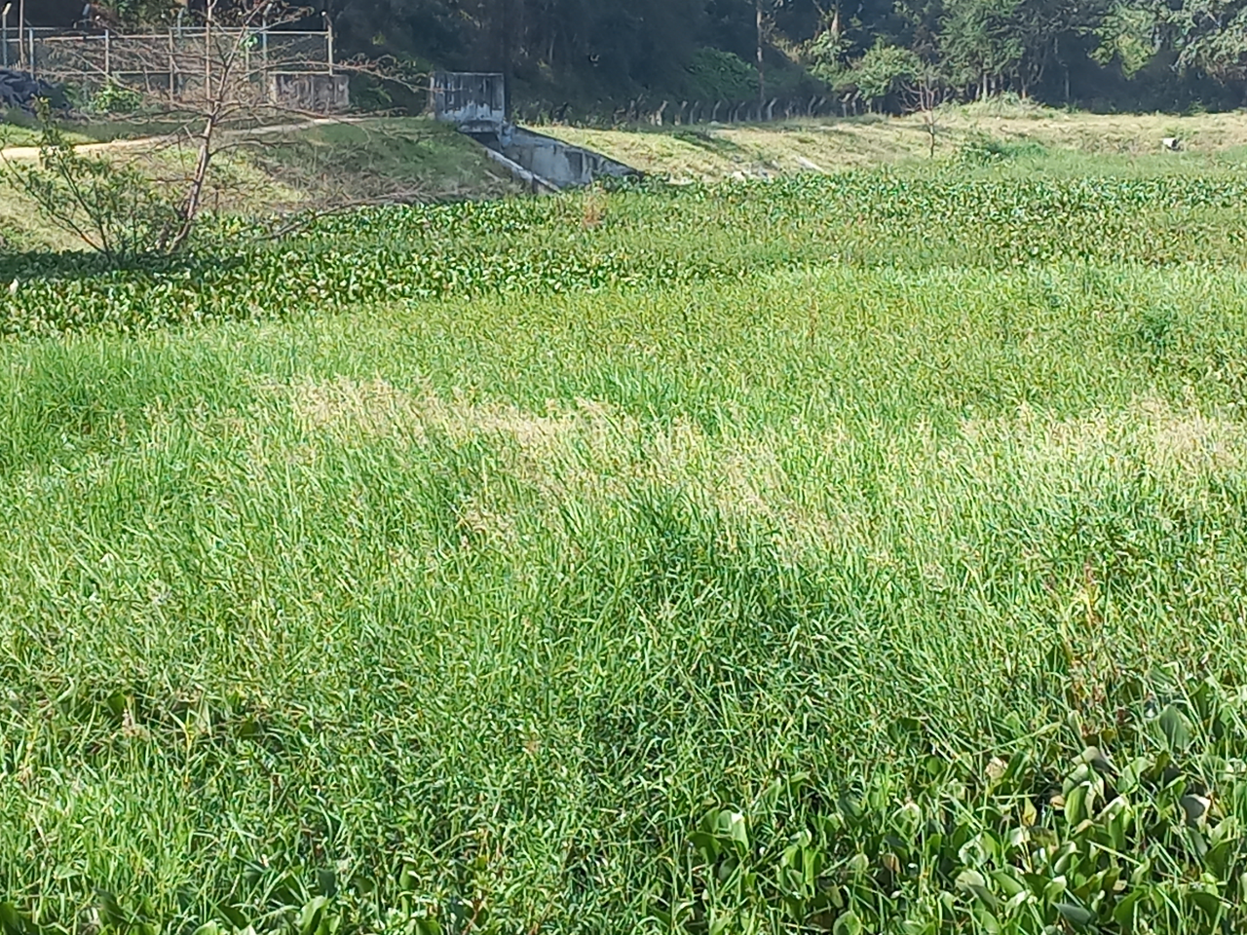
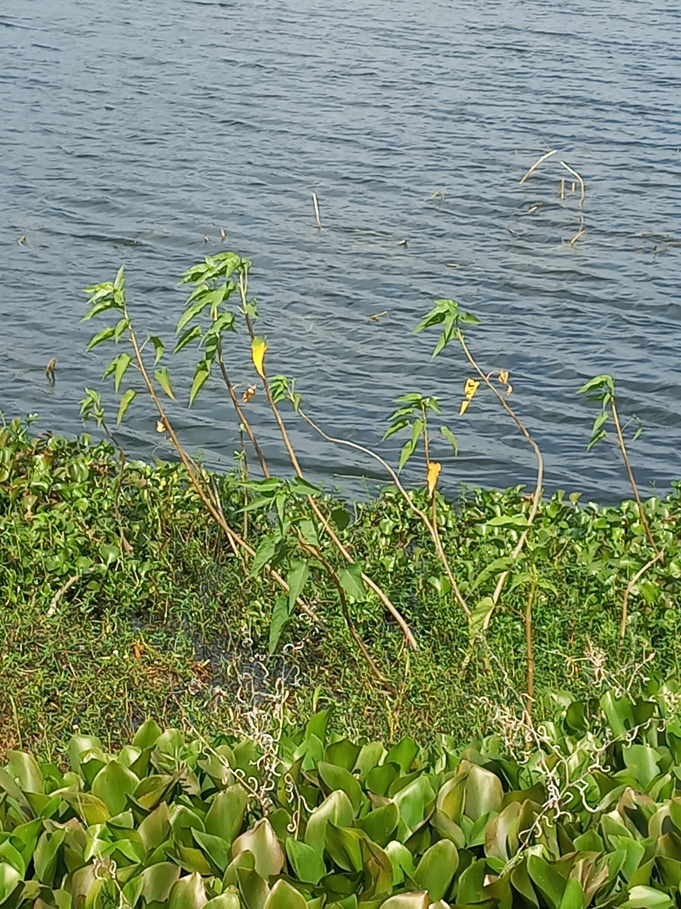
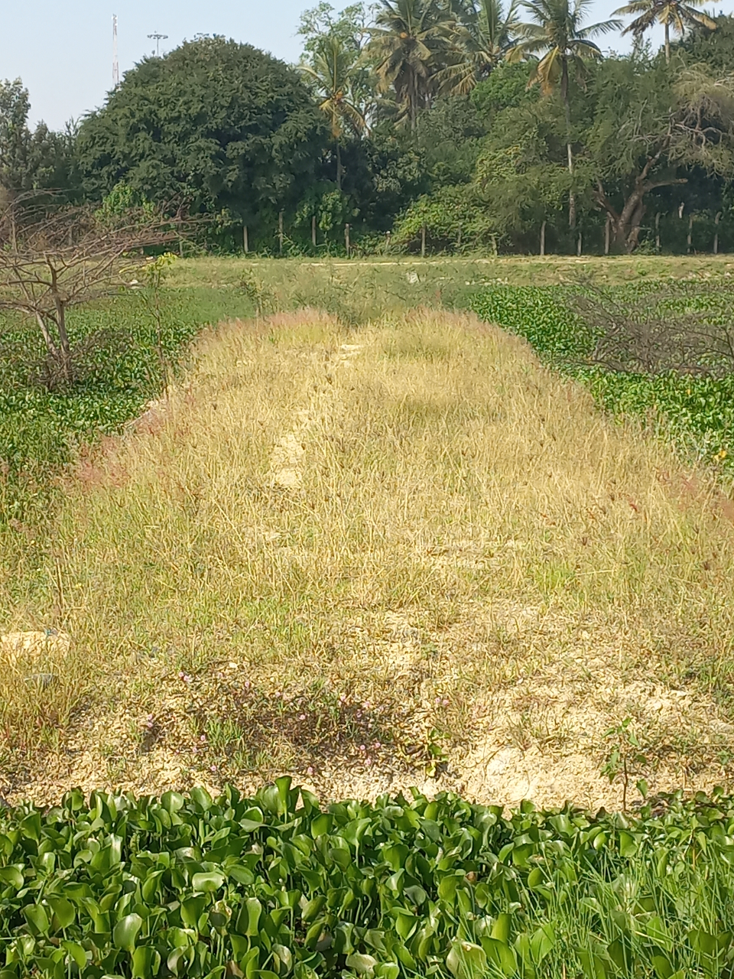
Asparagus Fern
(Asparagus racemosus)
Lilac Sage (Salvia verticillata)
Waterthyme
(Hydrilla)
Tree dahlia
(Dahlia excelsa Benth.)
Purple Fountain Grass
(Pennisetum setaceum rubrum)
Biscuit Grass
(Paspalumvaginatum)

Slide 19
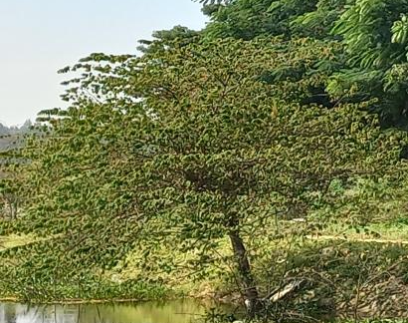
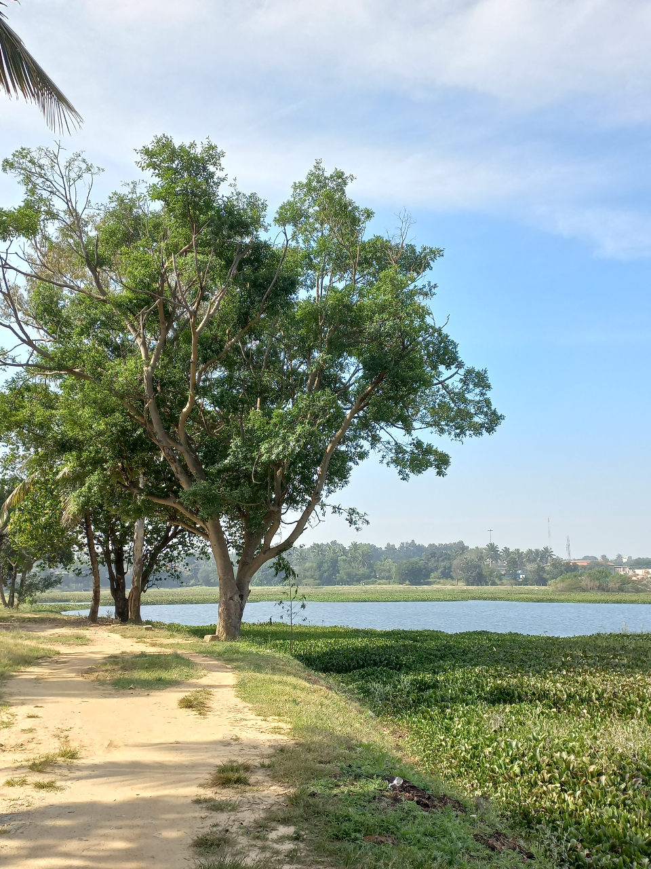
Beech
(Fagus sylvatica L. )
Mahogany

Slide 20
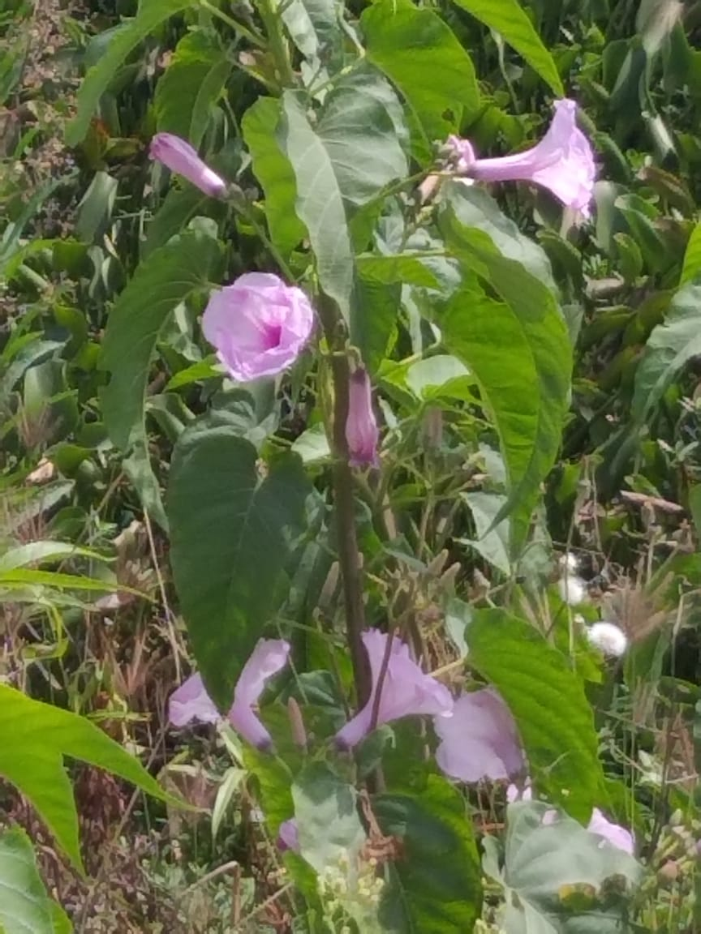
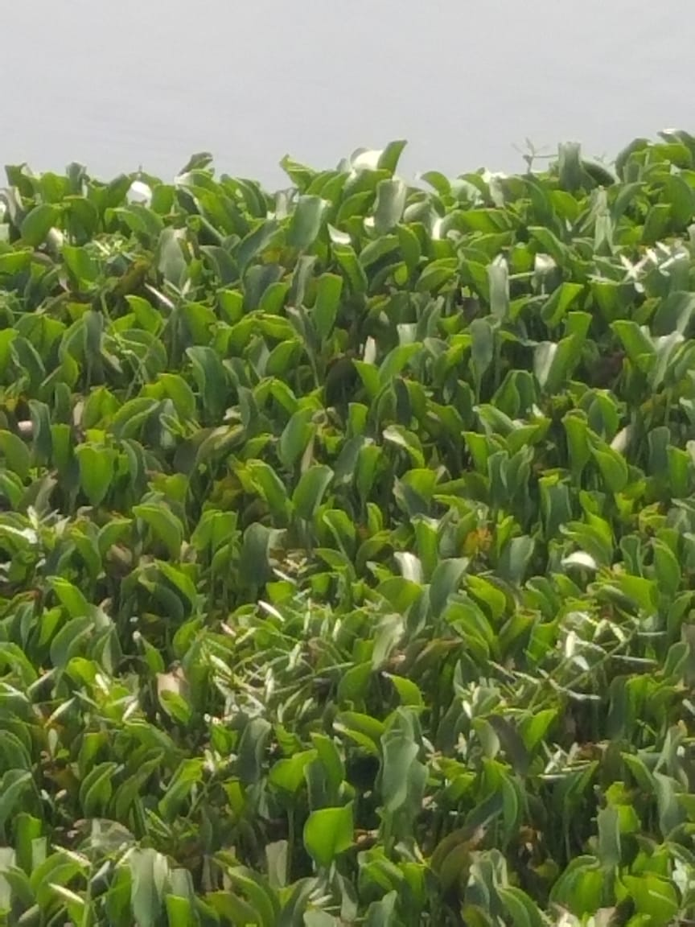
7. Gallery (BEGUR LAKE)
Giant milkweed
(Calotropis gigantea (L.) Dryand.)
Bush Morning Glory
(Ipomoea carnea)
Common Water-Hyacinth
(Eichhornia crassipes)
Slender Knotweed
(Persicaria decipiens)

Slide 21
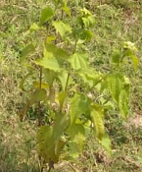
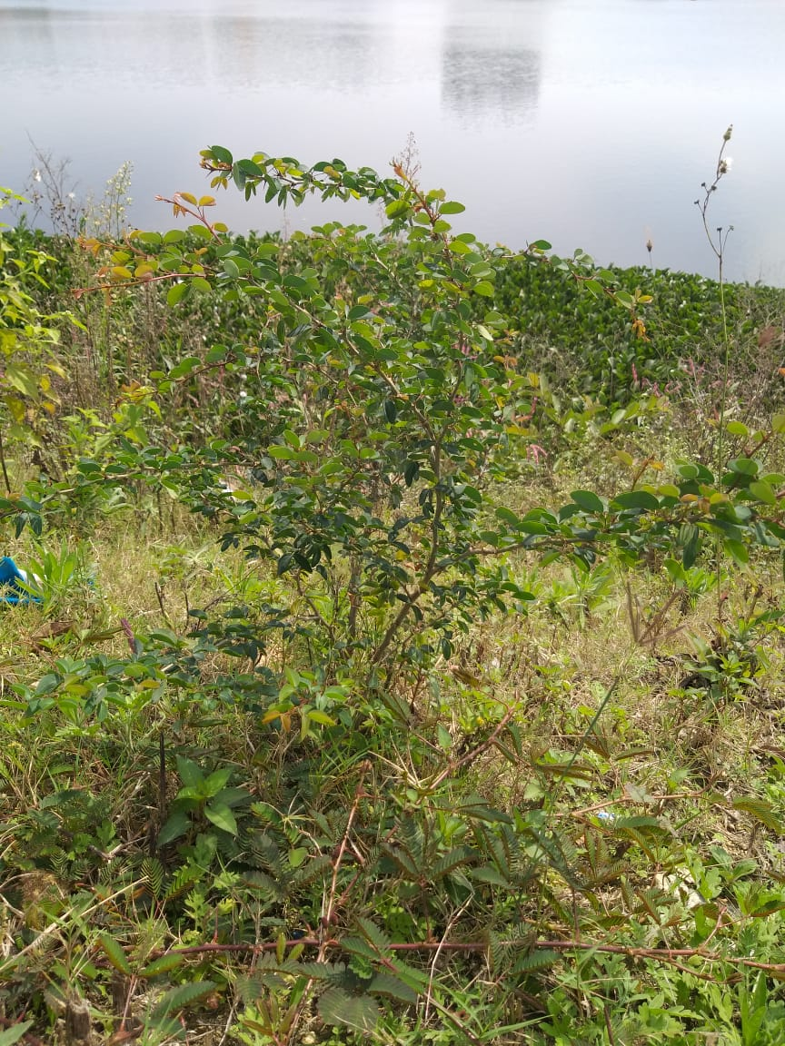
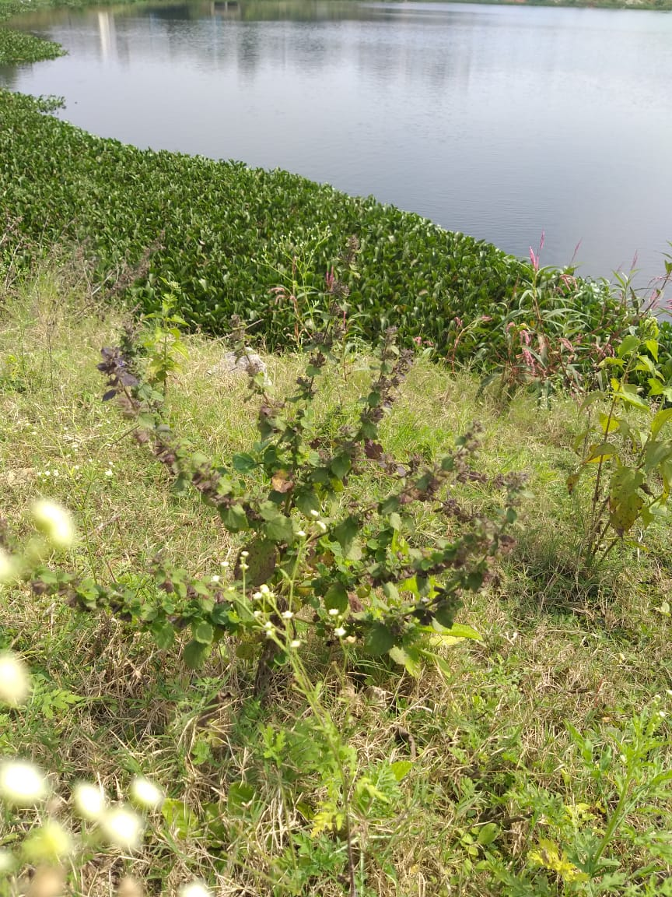
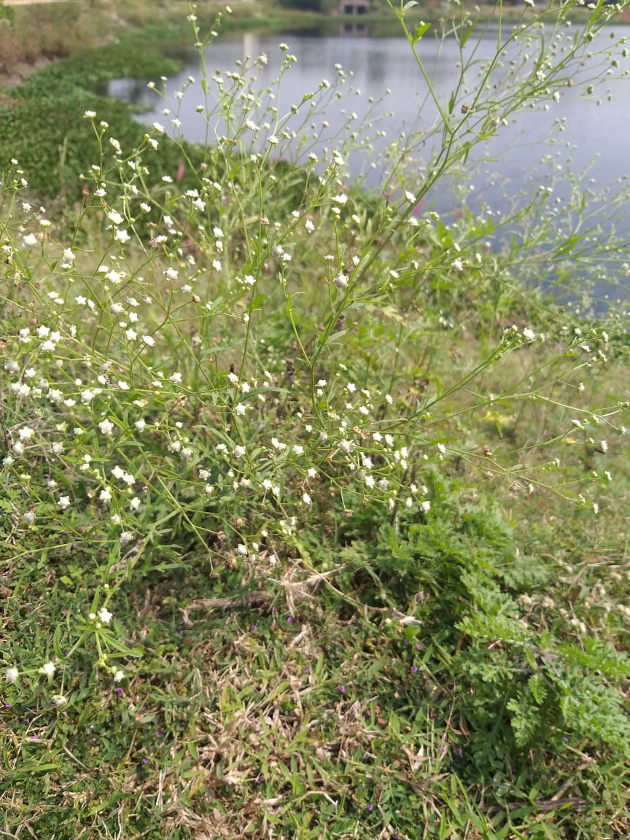
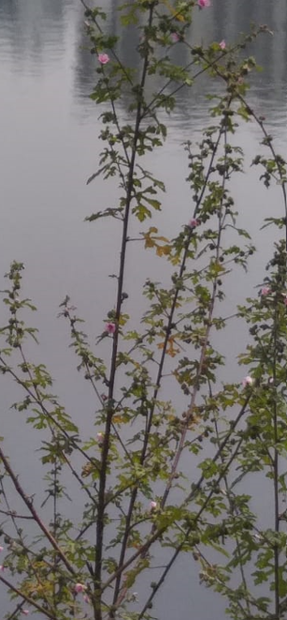
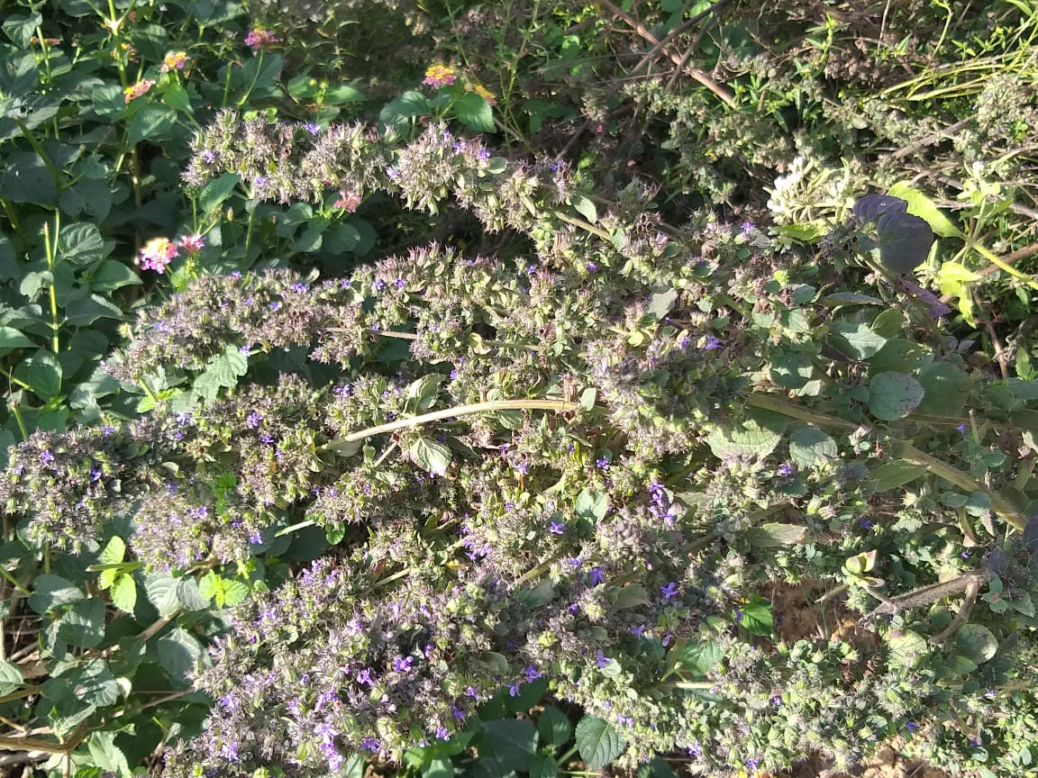
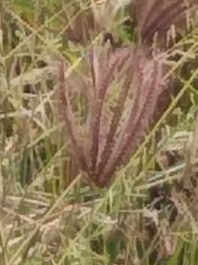
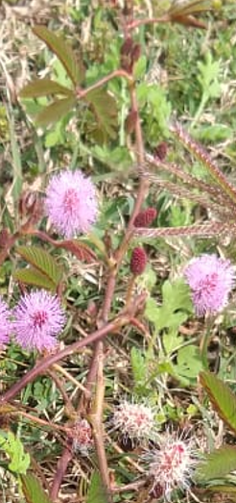
Pignut
(Hyptis suaveolens)
woolly burdock
(Arctium tomentosum Mill.)
Whitetop weed.
(Parthenium hysterophorus L.)
Swollen fingergrass
(Chloris barbata Sw.)
Lilac Sage
(Salvia verticillata)
touch me not,
(Mimosa pudica L. )
Leguminosae
(Mimosa monancistra Benth.)

Slide 22
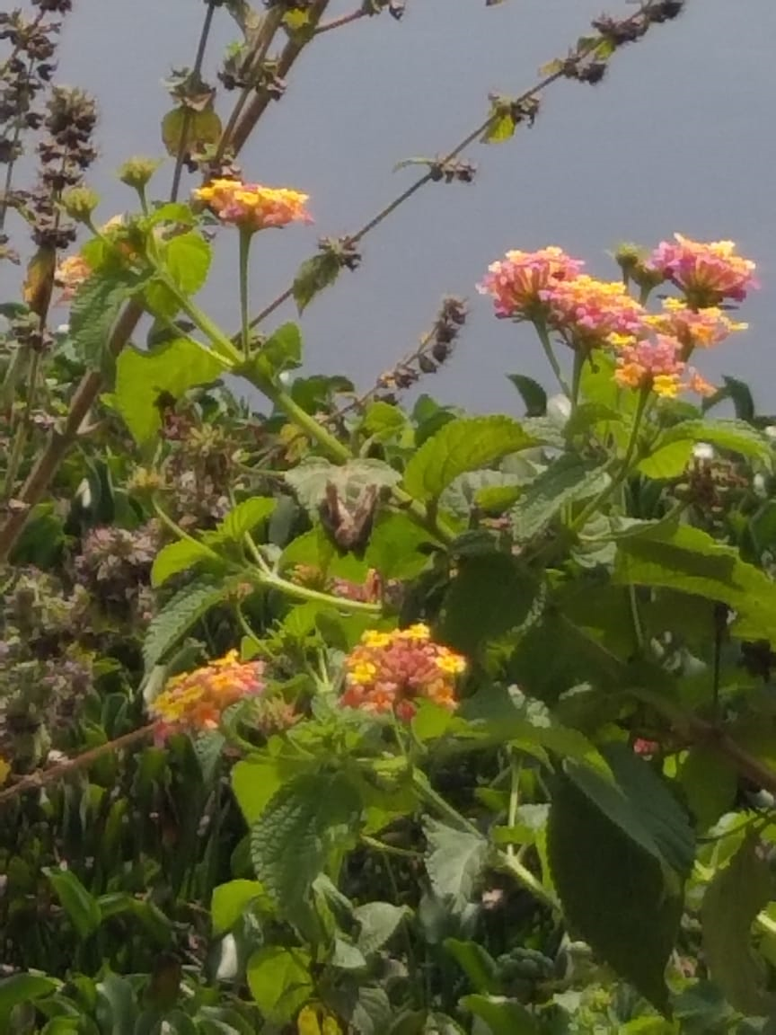
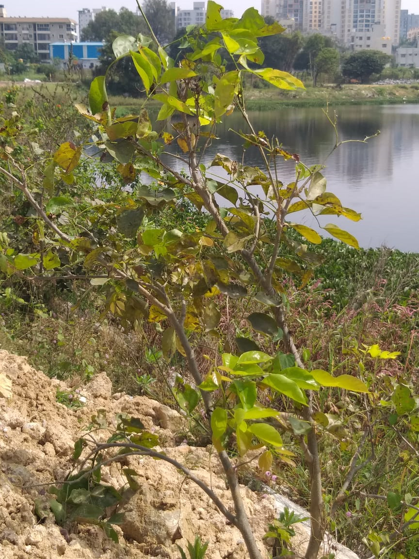
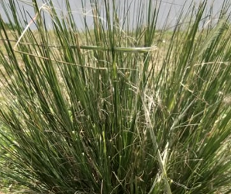
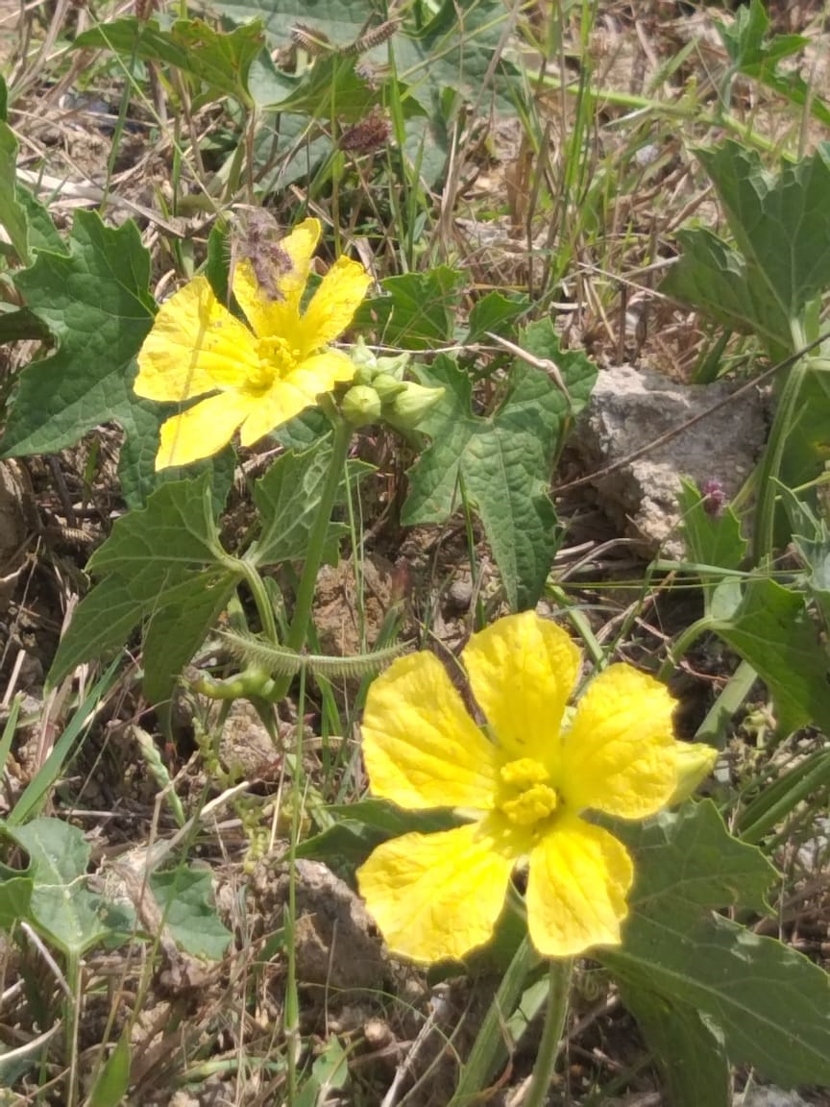
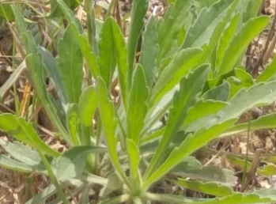
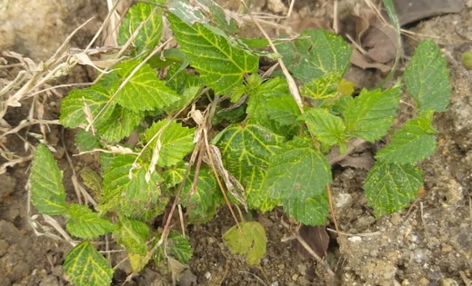
Roundhead bulrush
(Scirpoides holoschoenus )
Common lantana (Lantana camara L.)
Lemon
(Citrus limon)
Garcke Broomweed
Malvastrum coromandelianum (L.)
Chinese-okra
Luffa acutangula
Tall fleabane
Erigeron sumatrensis Retz.

Slide 23
8. Conclusion and Discussion
1. Both the lakes are being developed and have fenced boundaries
2. Water is mostly clean at the center, but the inlet and outlet areas were not well maintained. Diverse aquatic life is also present.
3. Diverse vegetation is present around the lakes. However, the current vegetation itself must be preserved, and the density of vegetation must be increased.

Slide 24
9. Acknowledgement
We would like to thank IISc for hosting LAKE Conference 2022 and giving us this opportunity.
We also would like to thank Principal Ma'am for letting us participate in the same.
We would like to extend our thanks to Indumathi Ma'am and Ashwini Ma'am for guiding us with the project.
We also give our heartfelt thanks to our parents for taking us to the sites for data collection.

Slide 25
10. References
All plants have been identified using https://identify.plantnet.org/
All the photos have been taken by the presenters and have not been plagiarized.
Macrophytes as bioindicators. Kohler, A. & Schneider, Susanne. (2003). Archiv für Hydrobiologie, Supplement. 147.
We were inspired by https://wgbis.ces.iisc.ac.in/energy/lake2022/

